Slide 1


CLINICAL EDUCATION
Post-Surgical &
Cardiothoracic
Physiotherapy
Advanced Physiotherapist
Peter Chong

Slide 2
Study Day Overview
10:00–11:00
11:00–12:00
Post-Surgical Rehabilitation
Physiological Consequences of Surgery
12:00–13:00
14:00–16:00
Post-Op Assessment & Early Mobilisation
Practical: Post-Surgical Rehab
16:00–17:00
Skills Suite: Applied Bedside Skills

Slide 3
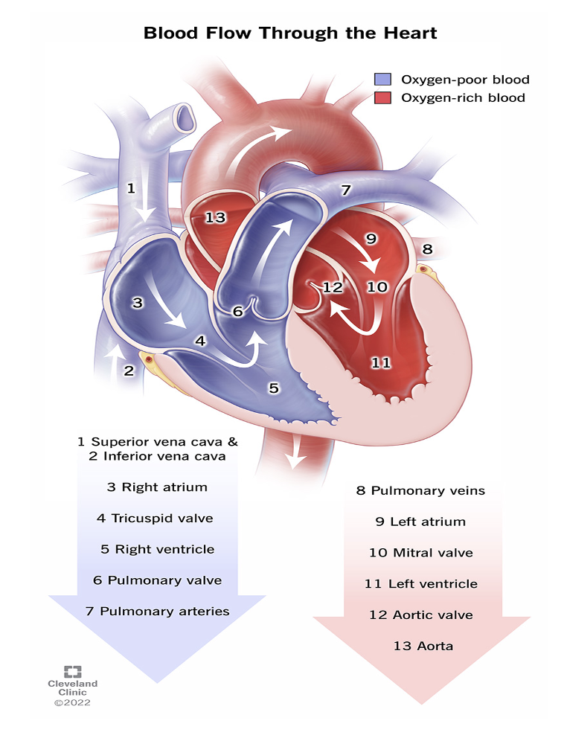
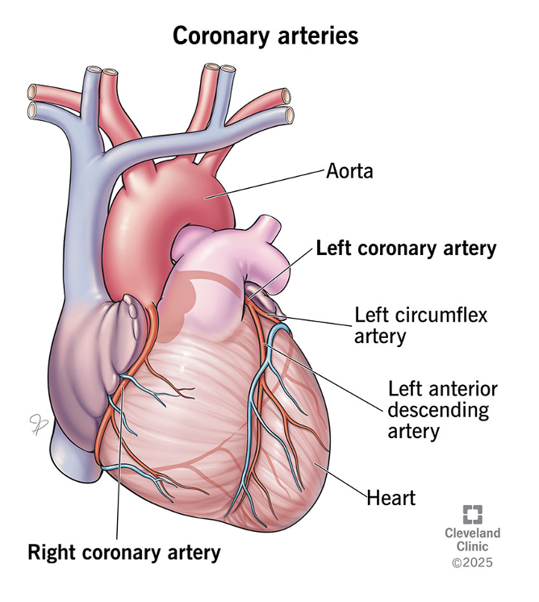
Knowing it off by heart:

Slide 4
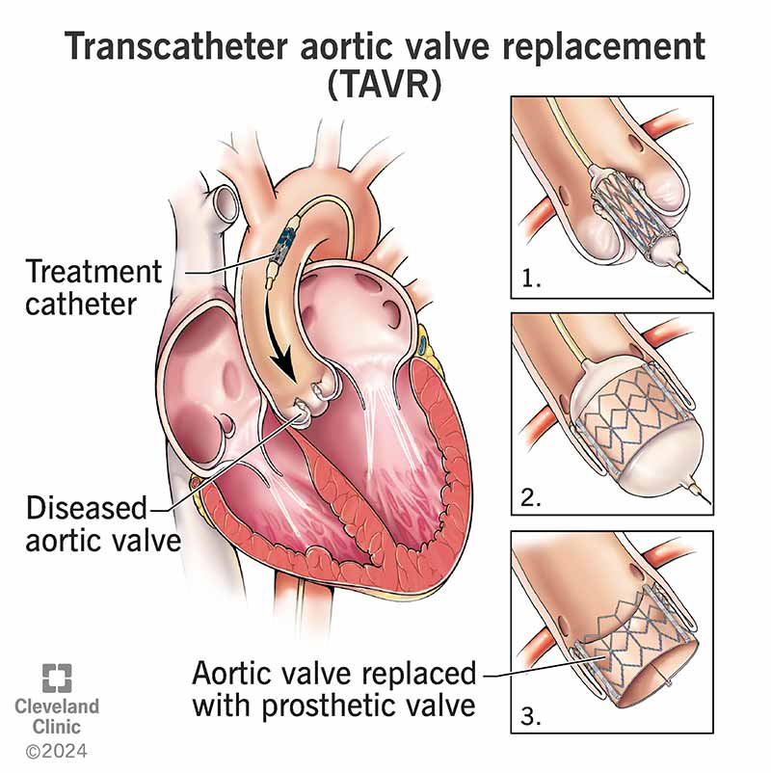
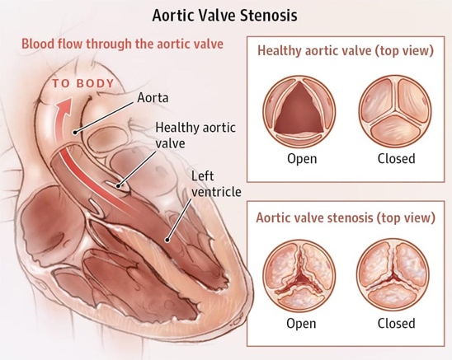
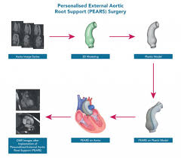
Common Heart Surgeries
Coronary artery Bypass Grafting (CABG):
Diverts blood around blocked arteries.
2. Heart Valve Repair or replacement: E.g. (TAVI) Aortic/ mitral valve replacement
Treats valve stenosis and regurgitation
3. Aneurysm repair: E.g. (PEARS) Open Aortic aneurism repair or Keyhole surgeries EVAR/ TEVAR
Replacing a damaged section with a synthetic graft.
4. Heart transplant:
Replacing your own heart with a doner heart

Slide 5
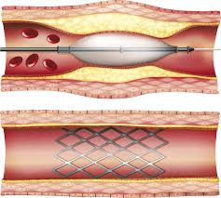
Other common heart surgeries: (not routinely seen by Physiotherapy unless requested
Arrhythmia Surgery: E.g. (Cardiac ablation):
Using ablation (hot or cold) to create small scars in the heart muscle blocking abnormal signals
2. Angioplasty/ stenting: E.g. Percutaneous coronary intervention (PCI):
open blocked or narrowed heart surgeries (Coronary artery disease) to improve blood flow

Slide 6
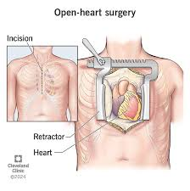
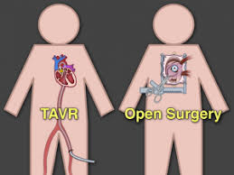
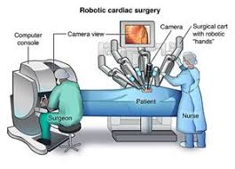
Procedure Types
Open Heart Surgery
Traditional Method. Involves sternotomy/ mini- sternotomy and incision is made through your sternum
2. Minimally invasive Heart Surgery/ Robotic Surgery:
Small incisions between the ribs of the side of the chest
3. Transcatheter Heart Surgery
A catheter is inserted through a small incision, usually in the groin (femoral artery), and guided to the heart.

Slide 7
Post-Surgical Rehabilitation
Cardiac Surgery Rehabilitation Pathways
Phase 1
Phase 2
Phase 3
Inpatient
Outpatient
Maintenance
Days 1–7
Weeks 6-8
Months 3–12+
A pre-op prior to surgery to prepare. Confirming HPC, PMHx, Shx, Mobility etc.
ICU: Initial Hx, Respiratory Ax, Bloods, Chest PT, ACBT, SOEOB / SOOBIC, passive AROM pain management
Cardiac Ward:
Day 1–2: Neck, shoulder and trunk exs, SOOBIC, ACBT, sternal precautions, mobilise
Day 3–5: Ongoing chest PT, progress mobility
Day 5–7: Stairs assessment & discharge education
Commences 6-8 weeks post-discharge
Structured exercise program: Aerobic ex: 50–85% HRmax or Borg 11–14
UL exercise program from weeks 6–8 (sternal healing)
Risk factor modification + psychosocial support
Community or home exercise programme
Sustained participation ↓ re-hospitalisation
Annual cardiology review
Ongoing PT for deconditioning or complications

Slide 8
Sternal Precautions:
The precautions apply for:
8 weeks for a full sternotomy.
4-6 weeks for a mini-sternotomy.
You may push or pull yourself up using both hands together, putting equal weight and stress through each arm.
No lifting anything heavier than approximately 5kg for the first 4-6 weeks after surgery (all heart surgeries).
Light housework and light gardening only from 6 weeks. Mowing the lawn, digging or hoovering can be resumed 12 weeks post-surgery.
No smoking: impedes healing and increases risk of infection
Walking Advice:
Aim to build up to longer walks of 30-45 minutes, 5 days a week within 4-6 weeks. Remember to always incorporate a warm up and cool down
Start with walking on level ground, building up to walks on inclines after a few weeks.
Walking and talking pace is the goal
  GOAL: 30 minute walks, 5 times a week, within 1 month after surgery.

Slide 9
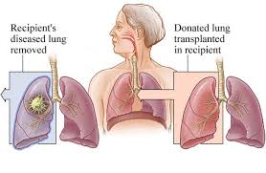
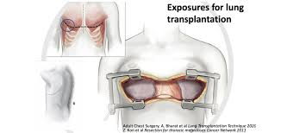
Lung transplant
A lung transplant is a surgical procedure for end-stage respiratory failure, replacing damaged lungs with healthy donor lungs
Procedure: A surgeon makes a large incision—either a "clamshell" incision (across the chest) or on the side (thoracotomy)—to access the lungs.

Slide 10
Lung Transplantation Rehabilitation Pathway
- Similar to cardiac.
- However, unlike heart transplants, which monitor for coronary vasculopathy, lung care prioritizes airway health and rejection.
- Focus is on pulmonary management.
- Immunosuppressants for the remainder of their life .
- Activity Restrictions: For the first 6–8 weeks, patients must avoid pushing, pulling, or lifting more than 5kg
Key Transplant Precautions
Infection prevention
Strict hand hygiene, PPE for all chest physio, avoid shared gym spaces
Rehabilitation Pathway
Inpatient
ICU (1-7 days)→Ward
(2-3 weeks)
More consistent and intensive PT respiratory management and assessment
Chest PT, SOEOB, mobility (avoid excessive forced exhalation)
Denervated lung = no distal cough reflex (ACBT important)
Passive → active limb exercises within 24–48h
Rejection
Declining FEV1 >10%, fever, malaise → suspend exercise, urgent review
Osteoporosis
Avoid high-impact loading; weight-bearing exercise + DEXA surveillance caused by immunosuppressants
Early Outpatient
(1–6 months)
Monitoring
Pulmonary rehab from 4–8 weeks post-transplant
6MWT as key outcome measure
Aerobic: start at Borg 10–12, progress incrementally
Frequent follow-ups include blood tests, chest X-rays, and pulmonary function tests to monitor for signs of acute or chronic rejection.
Long-term
(6 months+)
Community or home exercise maintenance
Osteoporosis prevention (steroids → bone loss)
Monitor for Chronic Lung Allograft Dysfunction (CLAD) : declining FEV1 = urgent review

Slide 11
Cardiac Contraindications
Vs Lung Transplant Contraindications
Cardiovascular instability
Resting HR >100 bpm with haemodynamic compromise, or new/uncontrolled arrhythmia (e.g. rapid AF, sustained VT, new heart block)
Systolic BP <90 mmHg or MAP <65 mmHg not responsive to fluid or vasopressor titration
New or evolving myocardial ischaemia (ECG changes, rising troponin, chest pain)
Active haemorrhage or coagulopathy
Chest drain output >200 mL/hour (active surgical bleeding)
INR or coagulation profile indicating uncontrolled coagulopathy - particularly relevant in the early post-CPB period
Respiratory failure
SpO2 <88% on current oxygen therapy despite optimisation, or FiO2 requirement >0.6 at rest
Acute tension pneumothorax or large untreated pneumothorax
Cardiac surgical specifics
Sternal instability confirmed or strongly suspected (palpable click, paradoxical movement): all active physiotherapy halted until surgical review
Tamponade - rising drain output followed by sudden cessation, hypotension, raised JVP, muffled heart sounds (Beck's triad): immediate surgical emergency
Systemic
Uncontrolled pyrexia >38.5°C with haemodynamic compromise (simple post-operative fever without instability is a relative precaution, not absolute)
Severe uncorrected electrolyte disturbance - particularly hypokalaemia <3.0 mmol/L or hypomagnesaemia (arrhythmia risk with exertion)
Altered consciousness or acute agitation precluding safe participation and command-following
Lung specific Contraindications
- Active, uncontrolled infection (bacterial, viral - particularly CMV, fungal - Aspergillus) - exercise during acute infection significantly increases rejection risk and systemic compromise.
- Acute rejection episode (confirmed or suspected) - evidenced by declining FEV1 (>10% from personal best), fever, malaise, radiographic infiltrates.
- Haemodynamic instability: resting HR >120 bpm, systolic BP <90 or >180 mmHg, new or worsening arrhythmia.
- Active haemorrhage, significant anaemia (Hb <70 g/L), or uncontrolled coagulopathy.
- Severe electrolyte disturbance (especially hypokalaemia, hypomagnesaemia)

Slide 12
Relative Precautions for transplants:
Osteopenia/Osteoporosis (universal in long-term steroid/immunosuppressents users): avoid high-impact loading, contact activities, or exercises with significant fall risk. Tailor resistance training to bone health.
Skin fragility and wound healing impairment: monitor incision sites carefully; avoid prolonged pressure or friction.
Denervated heart (cardiac transplant): heart rate response to exercise is blunted and delayed — do not use HR alone for exercise intensity guidance. Use Borg RPE scale (12–14 target) or power output/speed as primary guides.
Absent cough reflex distal to bronchial anastomosis (lung transplant): patients cannot sense or clear secretions in transplanted segments normally — proactive secretion management protocols are essential.
Calcineurin inhibitor neurotoxicity: tremor, peripheral neuropathy, and rarely encephalopathy can affect exercise performance and safety.
Immunosuppression-induced diabetes (NODAT — New Onset Diabetes After Transplant): monitor blood glucose around exercise; hypoglycaemia risk with sulphonylureas.

Slide 13
Multidisciplinary Team & Transition to Outpatient Rehab
Physiotherapy
Doctor/ RMO
Nursing
Exercise Rx, chest physio, mobility, education, discharge planning
Medical optimisation, arrhythmia, medication titration
Wound care, drain management, vitals monitoring
Occupational Therapy
Dietitian
Pharmacist
ADL assessment, fatigue management, sternal precautions in daily tasks
Nutritional optimisation, cardiac diet, fluid balance
Anticoagulation monitoring, medication reconciliation
Social Work
Psychology
Cardiac/Pulmonary Rehab Coordinator
Home support packages, community rehab referrals
Anxiety/depression screening, ICU-acquired PTSD, adjustment
Outpatient enrolment, scheduling, progress monitoring

